Slide 1

Variance of immigrant earnings
Capstone Project
Syed Atef Alvi

Slide 2
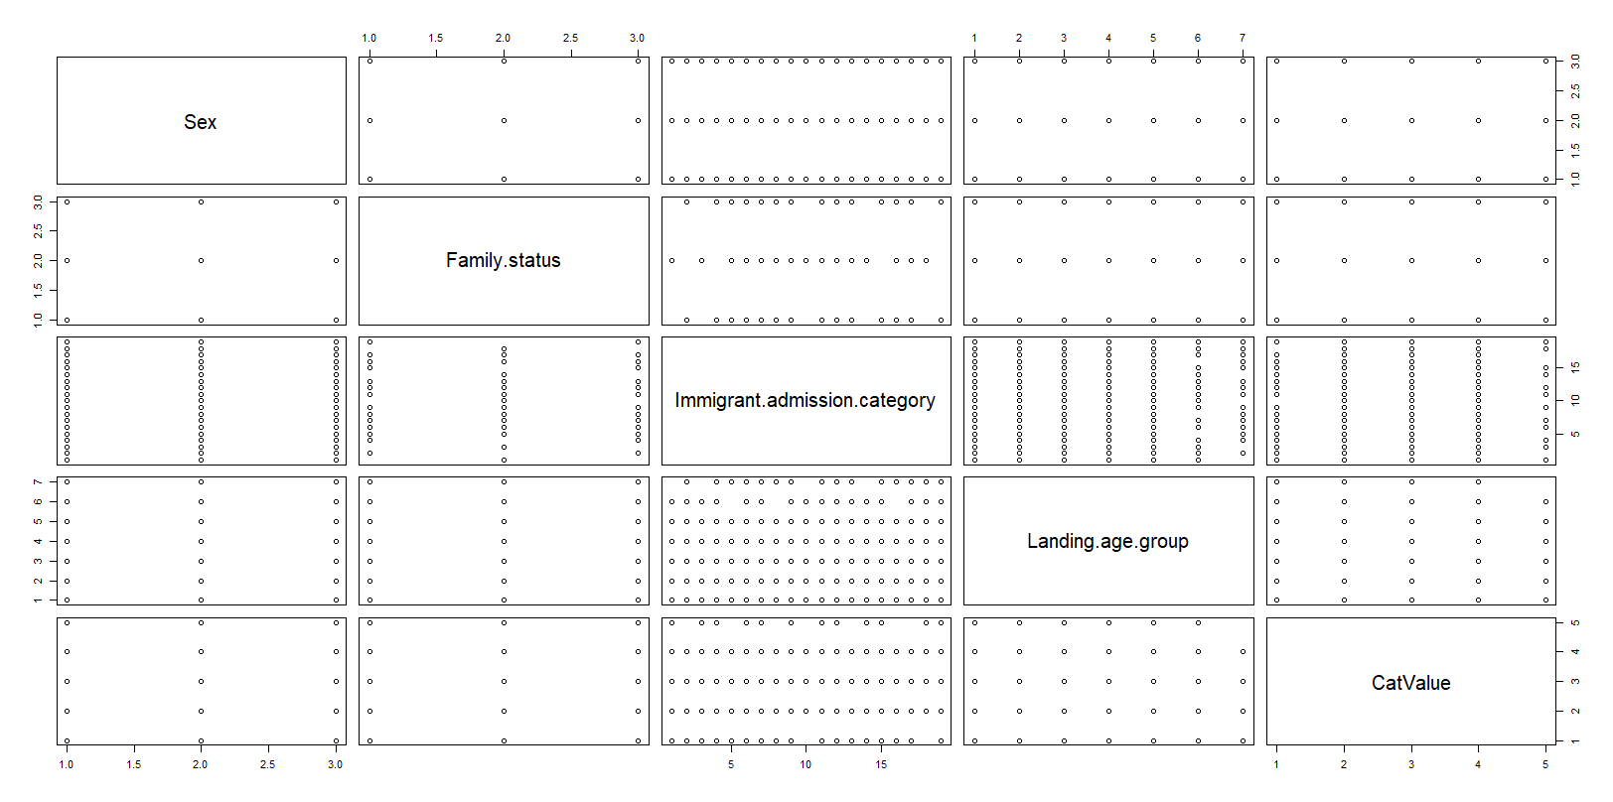
Data distribution

Slide 3
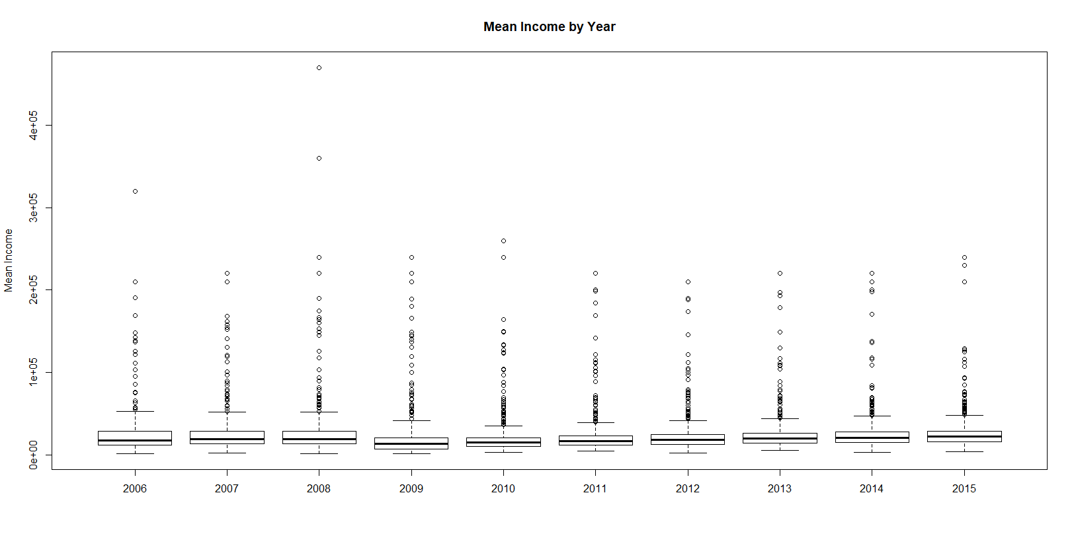
CatValue vs Year

Slide 4
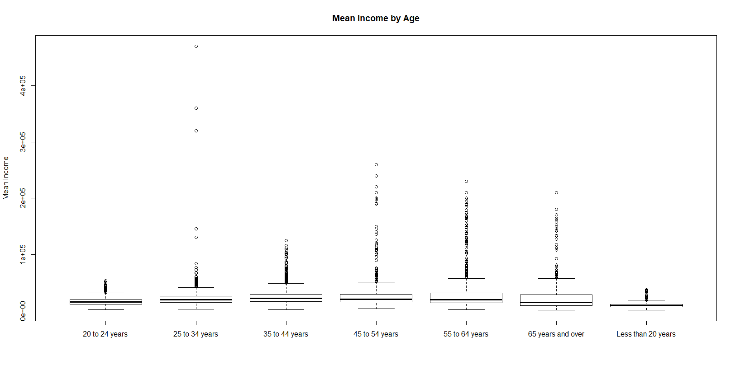
CatValue vs Age Group

Slide 5
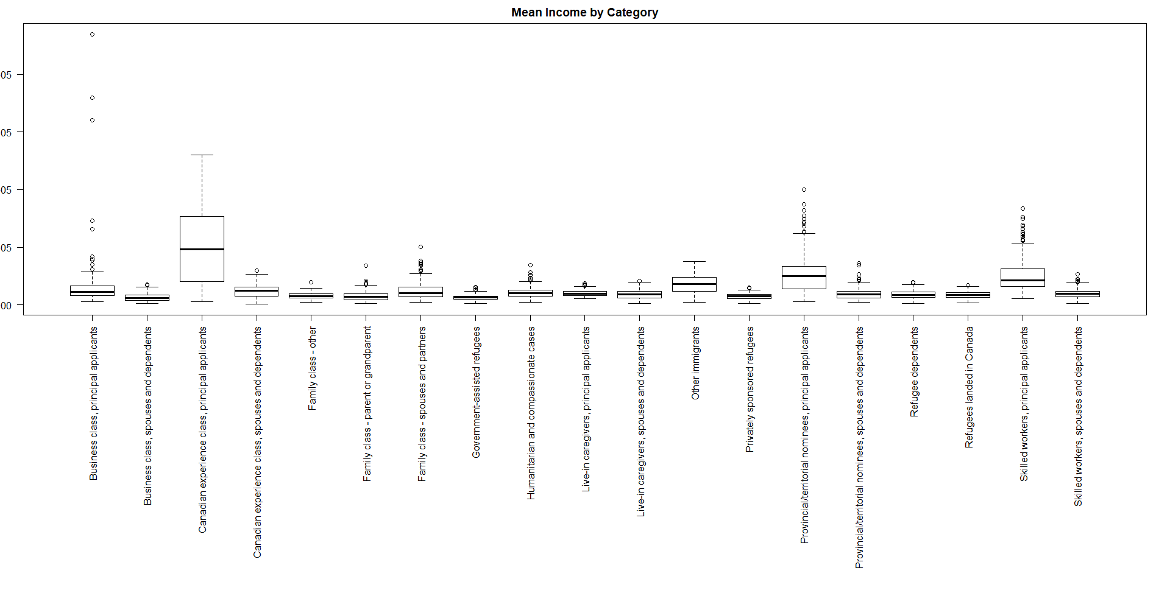
CatValue vs Immigration Category

Slide 6
Apriori High Income Rules
[1] {Immigrant.admission.category=Canadian experience class, principal applicants} => {CatValue=(4e+04,4.7e+05]} 0.02613312 0.7356322 7.41384 128
[2] {Immigrant.admission.category=Skilled workers, principal applicants} => {CatValue=(4e+04,4.7e+05]} 0.02062066 0.5401070 5.44330 101
[3] {Family.status=Principal applicants,Immigrant.admission.category=Canadian experience class, principal applicants} => {CatValue=(4e+04,4.7e+05]} 0.02613312 0.7356322 7.41384 128
[4] {Family.status=Principal applicants,Immigrant.admission.category=Skilled workers, principal applicants} => {CatValue=(4e+04,4.7e+05]} 0.02062066 0.5401070 5.44330 101

Slide 7
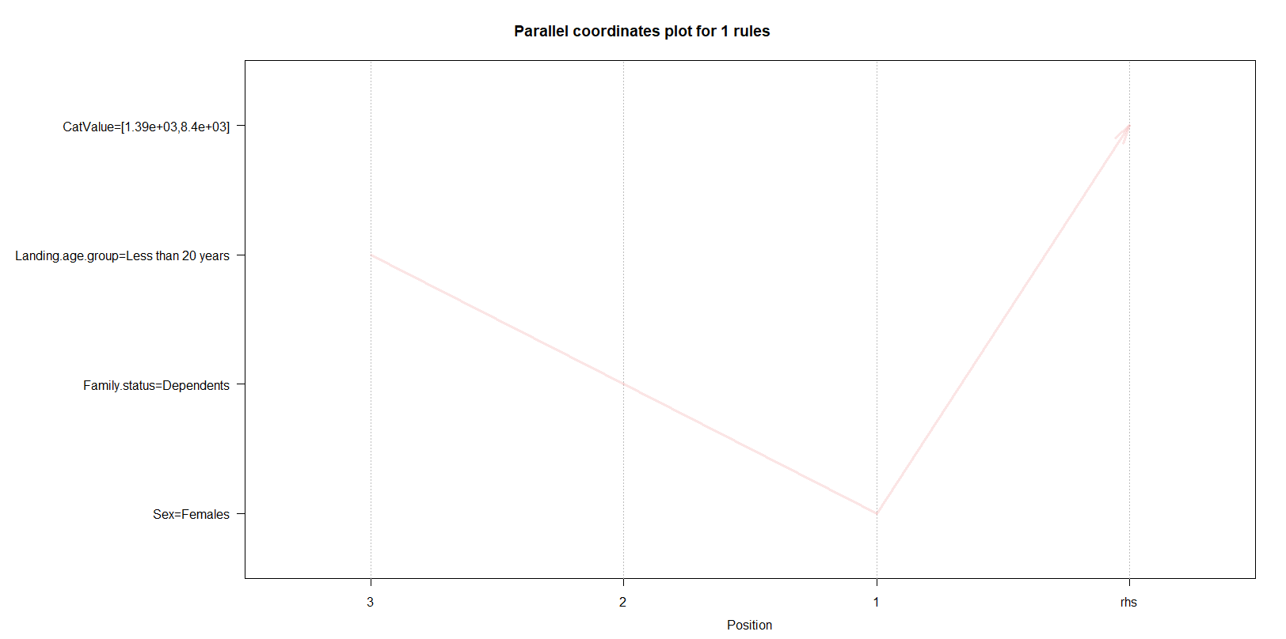
Apriori Low Income Rules

Slide 8
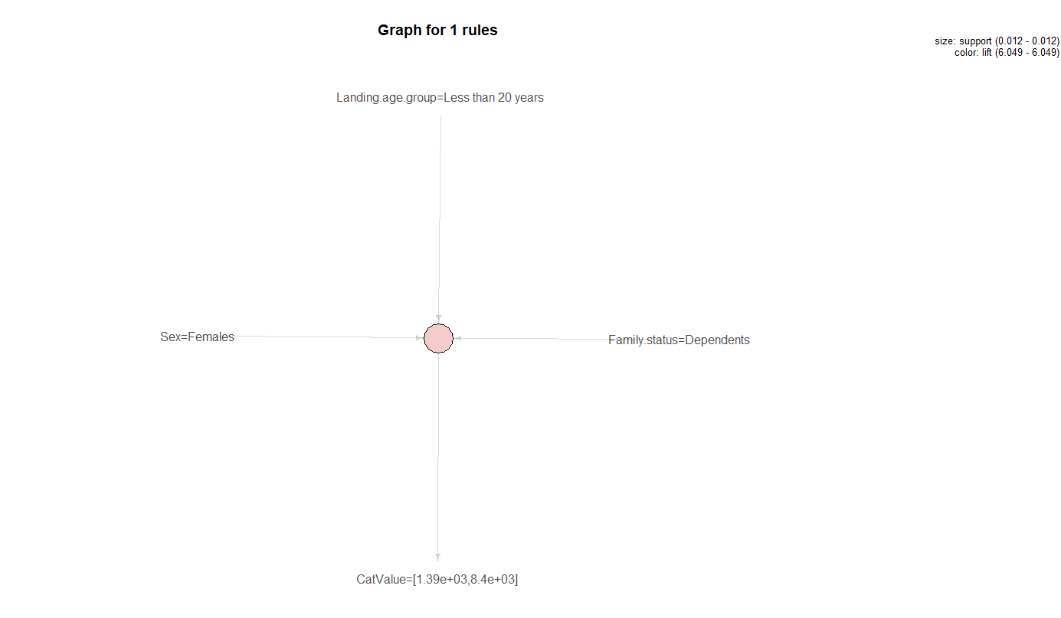
Apriori Low Income Rules

Slide 9
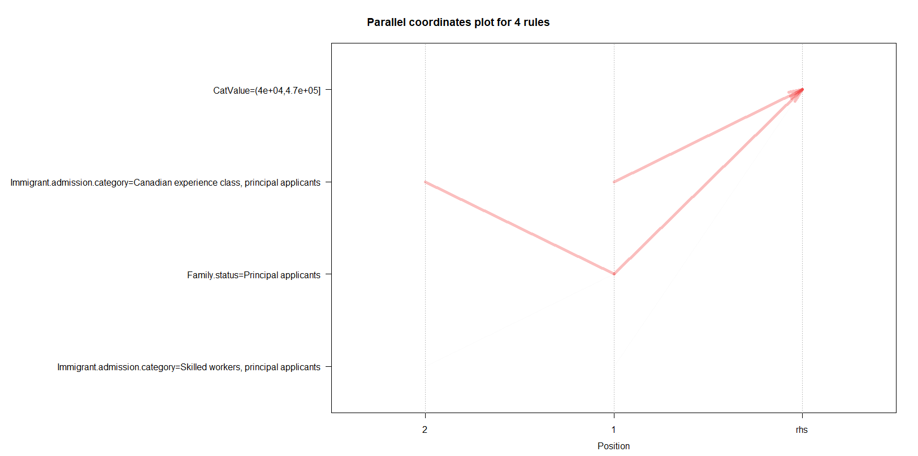
Apriori High Income Rules

Slide 10
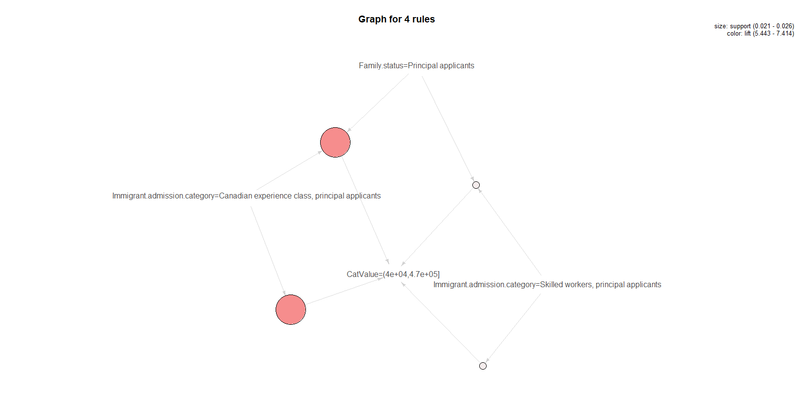
Apriori High Income Rules

Slide 11
Apriori High Income Rules

Slide 12
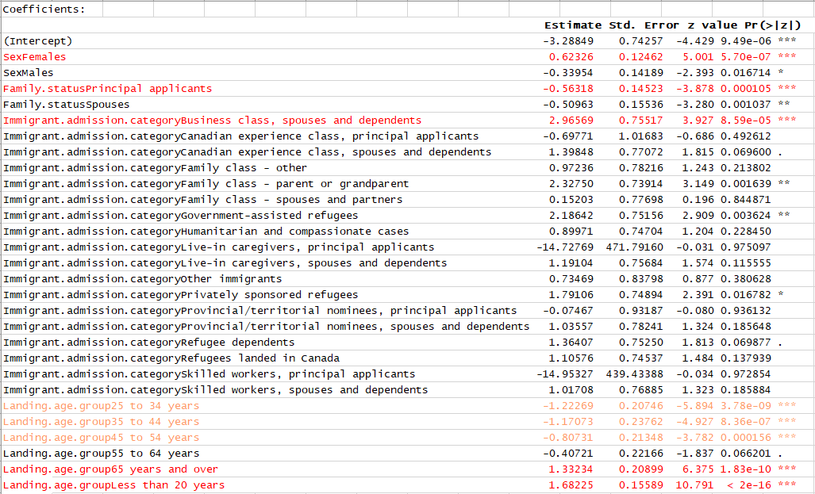
Binomial Low Income Rules

Slide 13
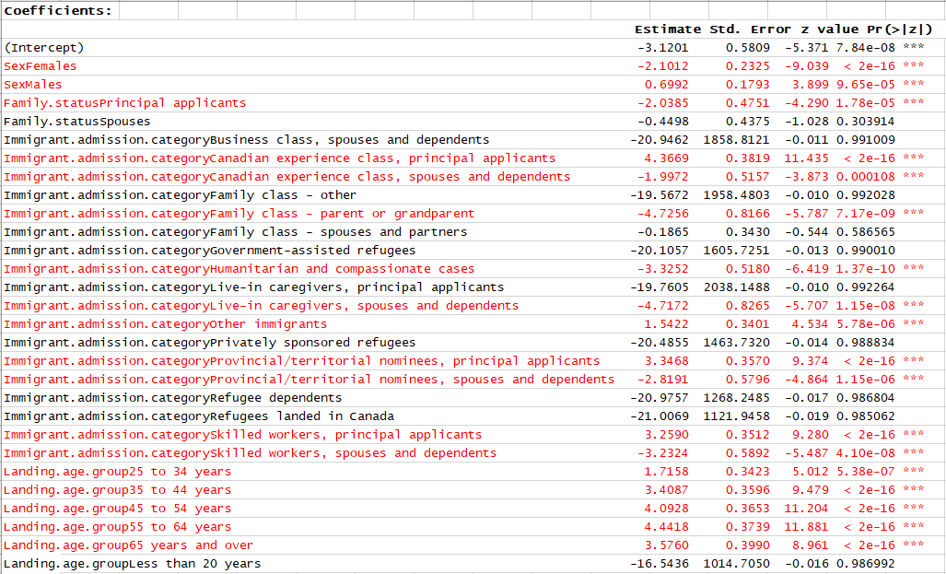
Binomial High Income Rules

Slide 14
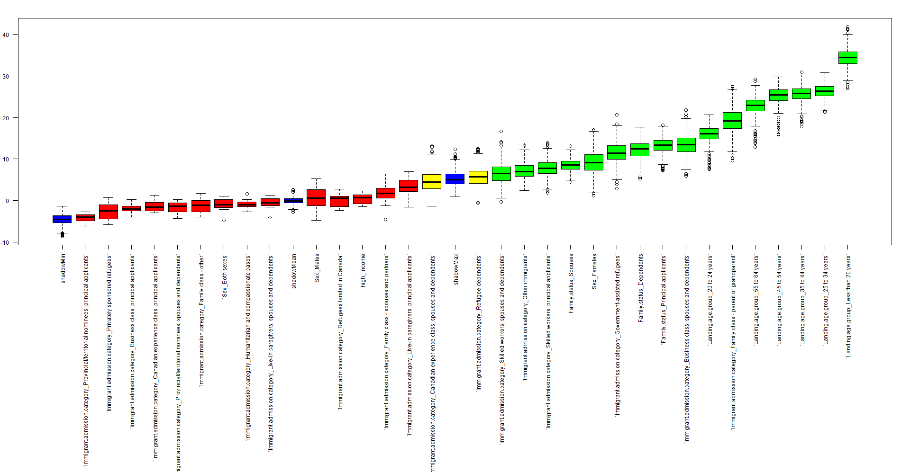
Boruta – Low Income

Slide 15
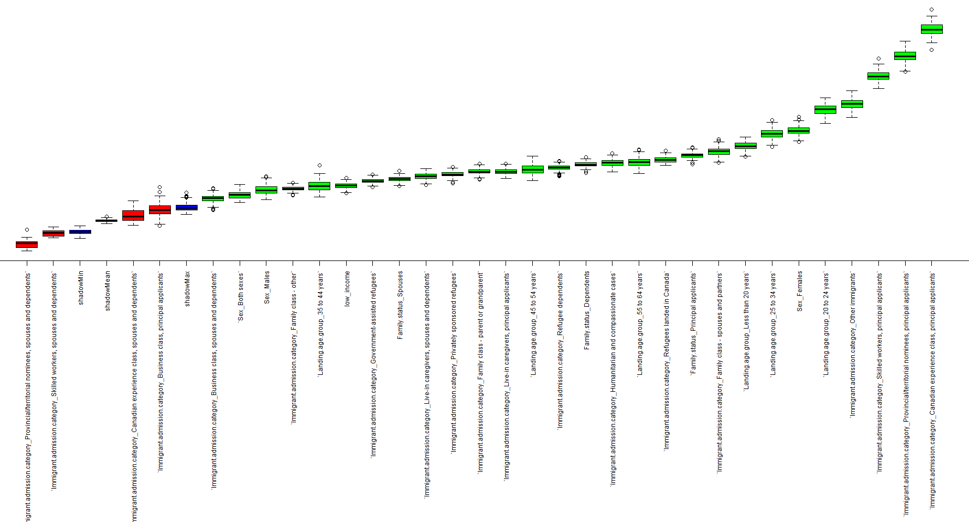
Boruta – High Income

